Slide 1
Executive Functioning
Session 2
Staff Presentation
15th February 2017
Notes:
Staff Presentation – 15th February 2017

Slide 2
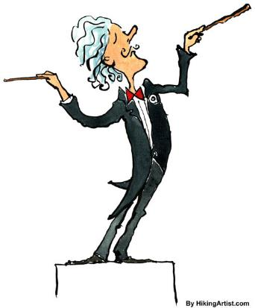
Executive Functioning
Cognitive capabilities that enable independent, purposeful, goal-directed behaviour
Notes:
EF: Skill that allows you to manage yourself, your time and your materials.

Slide 3
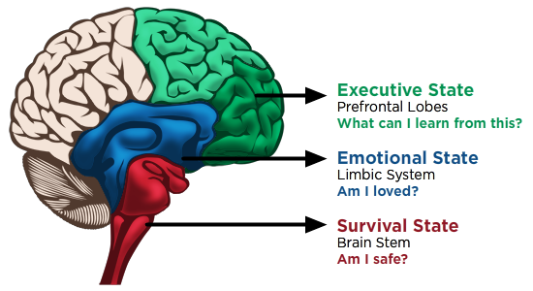
The Adolescent Brain
Triune Theory
English, 2016
Notes:
Survival: Instinct, breathing, swallowing, heartbeat. Fight, Flight and Freeze response. Releases adrenalin and cortisol – stress hormones.
Emotional: Emotions – memories, feelings, emotional reactions, play. When Limbic system is overstimulated – shuts down – no access to language or decision-making!!! Flip lid!
Frontal Lobe: Planning, language, logic and will, decision-making, organising, emotional and behavioural control, flexible thinking, attention, working memory, personality.

Slide 4
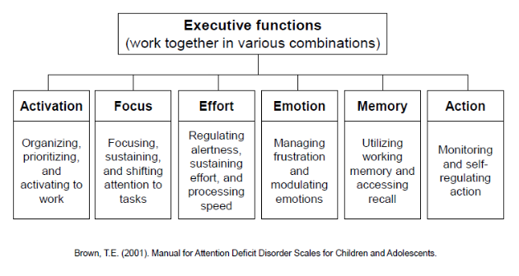

Slide 5

1. Activation
Planning and Prioritising
Organising
Initiating work
Challenges... Disorganisation, managing self and tasks, not prepared, struggle to keep track of tasks due/events, procrastination, oppositional when challenged to start, running out of time, short-term thinking, may skip steps in task, instant gratification, overwhelmed and shutting down...
Notes:
Challenges:.

Slide 6
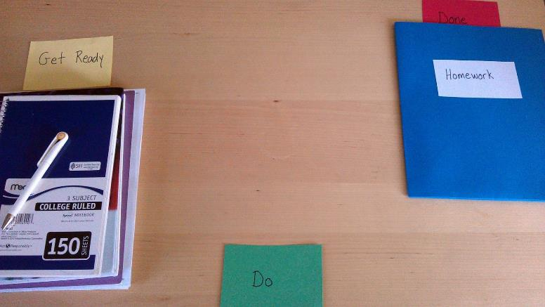
Strategies
Forward thinking – envisioning the end goal – Sequencing in visual:

Slide 7
Reverse Engineer the Plan
3. GET READY
2. DO
1. DONE (Future)
What do I need so I can start?
What STEPS do I need to take to get done?
Ask: What do I need to do to match the DONE picture?
What will it LOOK like to be done?
I.e., Examples from previous years
Notes:
Nick Example...
Teaching kids how to think and plan....
Look and FEEL
Training forward thinking (think in pictures)
Break into steps
Starting- verbal mediation cue...first...

Slide 8
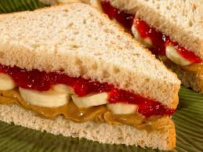

Strategies cont.
Instructions: PBJB Sandwich
Peanut Butter , Jam and Banana Sandwich

Slide 9
Strategies cont.
Place in context – big picture
Clear, explicit instructions - multimodal
Rubrics/model answers
Chunking tasks, with check points/dates
PRAISE! Rewiring for Success
Notes:
For activation, organisation, planning

Slide 10
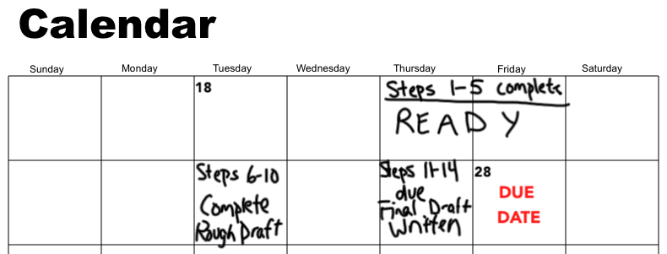

Apps for planning and organisation
MyHomework (iOS/Android)
Any.do (iOS/Android)
Remember the Milk (iOS)
Toggl
30/30(iOS)
Cold Turkey
Photos of the board/voice recording of instructions
Notes:
MyHomework App – homework scheduler and organiser
Any.do – reminders,to-do lists, notes and events
Remember the milk – priorities, due dates, time estimates, repeating lists, tags, etc.
Toggl – time tracking - graphs of websites/time – free, no download
30/30 – set timers to complete tasks
Cold Turkey – Windows. Blocks websites, timer. – download, free.

Slide 11
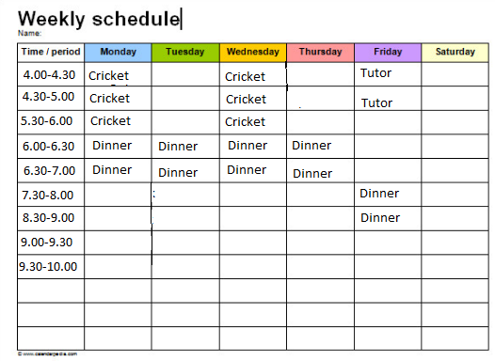
Strategies cont.
Schedules with core timetables
Notes:
Concept of time – Cold turkey/30-30. – begin to see what a day looks like - where can I steal time?
Time robbers – what is getting in the way of productivity

Slide 12

2. Focus
Sustaining attention
Selective attention
Shifting focus
  Challenges: Once started, easily sidetracked. Impulsive. Problems transitioning. Hyperfocus. Little awareness of behaviour implications with peers.
Notes:
To match demands of a task.

Slide 13
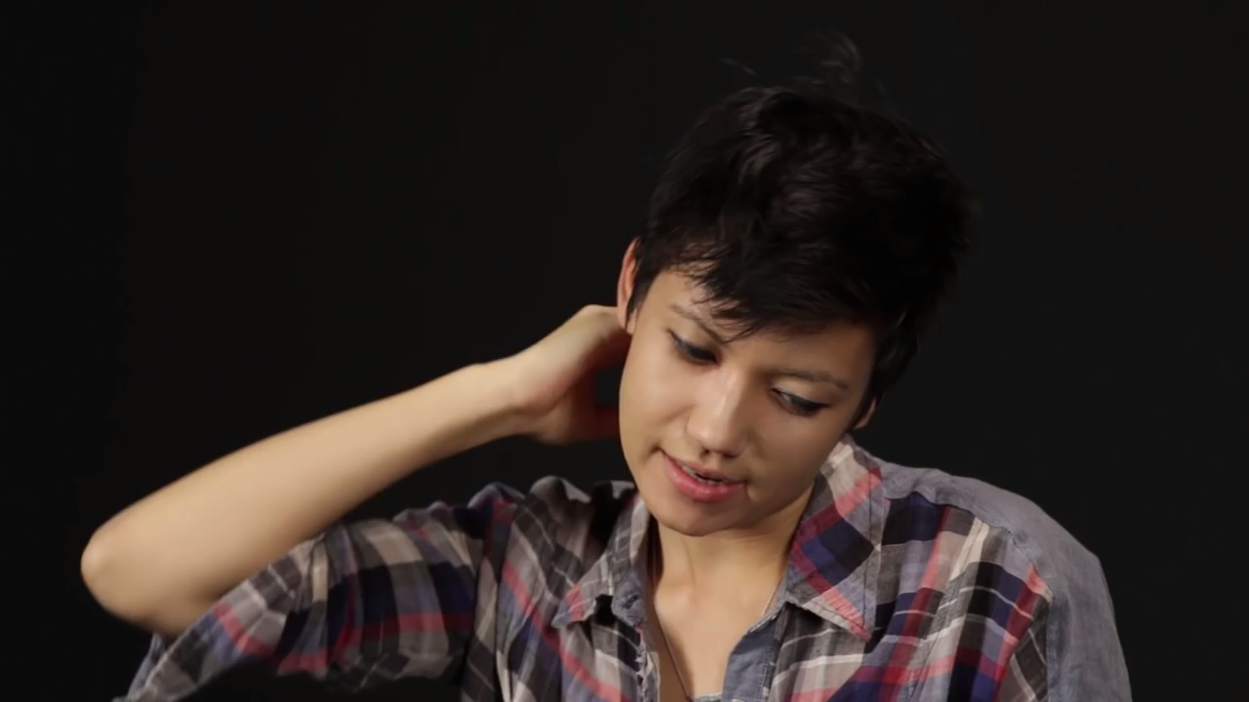
What ADHD Feels Like

Slide 14
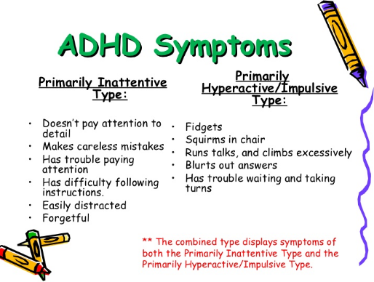
Notes:
Inattention – pre-frontal – immature and underaroused – takes more to wake them up – large, empty cup. Stimulant medication increases bloodflow to the front of the brain, and increase production of neurotransmitters. EEG programmes also increase bloodflow to the front, but longer. Train brain to refocus, engage more of prefrontal.
Inattentive – lower norepinephrine levels
Hyperactive – lower Dopamine levels

Slide 15
Strategies
Seating – negotiated
Secret cue
Incorporate student interests
Movement break/task
Silent timer
‘Rubbish’ fact
Stress blob
10 minute summaries/shining points
Challenges
Notes:
Challenges: “Few people know the answer to this....”
NOT one size fits all...adapt and connect.

Slide 16
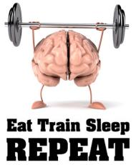
3. Effort
Regulating alertness
Sustaining effort
Time management
Sustaining processing speed
  Challenges: Drowsiness, forgetting the steps, instant gratification vs. perseverance, motivation, slow work speed, slow response time...
Notes:
Regular movement breaks
Timers/Watches

Slide 17
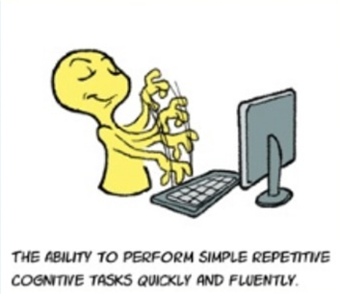

Processing Speed
Notes:
Processing speed: Take in stuff by eyes or ears, or motor reaction.
Classroom: Difficult to engage with a new concept. Easy to hide – can go and work hard/differently at home
Exam – can’t hide – can misinterpret the question. Miss steps, i.e., part 2 or 2/3 marks. Stress > slows down processing, more errors. Slower reading and writing. Quickly retrieving info from memory. Understanding and following directions. Trouble with social interactions -
Strategies: Extra time. Ask for notes from teacher, add in notes from textbook, record the lecture (video). Notes beforehand – track what is being said (Taking notes and listening slows processing speed). Time planning with additional time. Keep anxiety down by putting in work far ahead of time. Selling Support Classes: learning, giving your brain some time to absorb, and engaging again, helps information go from your working memory to your long-term memory. Break tasks into blocks, with due dates for each.

Slide 18
Strategies
Processing:
  Notes to follow in class, class buddy
  Take photos of the board/record instructions
  Time to sink in
  Time to process and formulate answer
  Learn far in advance
  Motivating for Support Classes

Slide 20

Questions?
Comments?
Stories?
Suggestions?

Slide 21
References
English, A (2016). Dan Siegal’s handy brain anatomy model. Retrieved 20 November 2016, 2016, from https://goo.gl/t9vYNY
Petrosky, E (2010). Executive functioning in the classroom. Retrieved 20 November 2016, from http://www.slideshare.net/epetrosky/executive-functioning-in-the-classroom-3424978
Scheiper, L. (2014).Task Planning and Execution: The Get Ready, Do, Done model. Accessed 19th October 2016, at https://prezi.com/mx7tr3k7nr71/task-planning-and-execution-the-get-ready-do-done-model/
DiPietro, B (2016). MyHomework Student Planner: An Introduction [Video file]. Accessed 1 February 2017, at https://youtu.be/8LAx0i2bAEU.
Kenney, L (2014). EF vol 9: Children and adolescents. Retrieved 12 February 2017, from http://www.slideshare.net/LynneKenney/kenney-ef-v4-children-and-adolescents-nov-2014
Buzzfeed (2015). What ADHD feels like. Retrieved 12 February 2017,from https://youtu.be/NL483G4xKu0
Hecker, L. (n.d.). The reading brain: Executive function hard at work. Retrieved 12 February 2017, from https://ldaamerica.org/the-reading-brain-executive-function-hard-at-work/
Excel in Exams (2015). What is slow processing, and how it can affect students. Retrieved 10 November 2016, from https://youtu.be/SiyBNZEuPPc

