Slide 1
Connection
Staff presentation,
Bishops
10 April 2019

Slide 2
Think of:
Your best kind of student:
Habits
Attitude
How you react
Worst/most challenging student:
Habits
Attitude
How you react
Notes:
Best – comes naturally to them!
Worst – can be super hard for them!

Slide 3
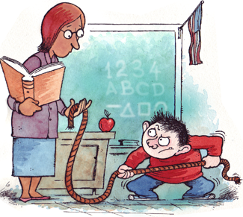
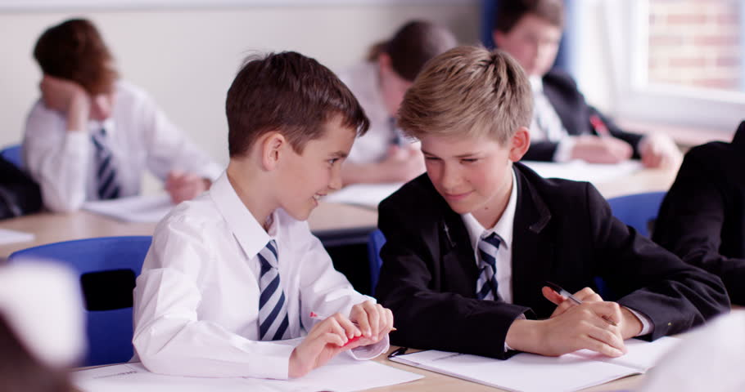
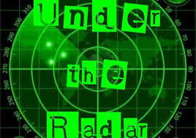
Responses
Notes:
Off-task – may be unaware – can be frustrating for teachers, but still learning skills
Power struggle – power or attention – battle of wills to hide fear - still matters to them enough to battle.
Under the radar – your expectations are too high for me – set a new bar (which can be none!) that I feel I can reach
Head in the sand – pretend I don’t know – I couldn’t try hard because I didn’t know
Giving up – I can’t - It’s now more important to you than me.

Slide 4
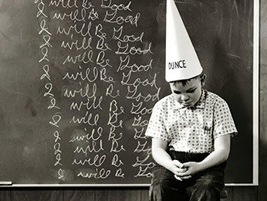
Shame and stigma
Stigma – mark of disgrace, from our community
Shame – feeling bad about who you are and what you do or don’t do.
Shame is the only emotion that does not seek expression - try to hide the secret: We don’t believe we have/can achieve what everyone else has/can!
From Shame and Stigma to Pride and Trust – Drs Hallowell and Dodson (2018)
Notes:
Stigma – mark of disgrace – learnt behaviour in response to community
Shame – feeling bad about ourselves

Slide 5
Fear response in teens
“HOT” thinking Amygdala hijack
“COOL” thinking
Once a teenager's brain registers a threat and is activated, their ability to suppress an emotional response to the threat is reduced.
Weill Cornell Medical College
Notes:
Fist imagery!
Decision-making: “Hot” vs. “cool” cognition: “Hot” (less rational) arises when thinking under intense emotion and high arousal (fear of social rejection/need to look cool/disappointing people/arguing with parents) →amygdala responds with fight or flight reaction. “Cool” reacts (not lead by emotions) required for essential modelling from parents.

Slide 6
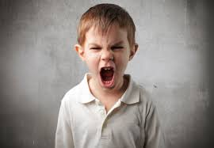
Challenging behaviour
#1 cause of teacher stress, drop out, and referrals for mental health services.
Kids do well if they can, not if they want to.
Lack the Skill, not the Will to behave as expected.
i.e., Problem-solving, flexibility, frustration tolerance OR learning difficulty/disability.
Difficulties > opportunities to practice collaborative problem-solving.
Dr Stuart Ablon – Director of Think:Kids – Collaborative Problem-Solving.
https://youtu.be/zuoPZkFcLVs
Notes:
Note for link: Dr. Stuart Ablon, Director of the Think:Kids program in the Department of Psychiatry at MGH, describes the general tenets of a model of care called Collaborative Problem Solving, which was originated by Dr. Ross Greene in his book The Explosive Child.
Different rates of development – it’s ok for kids to suck at problem-solving, flexibility and frustration tolerance at 2 – but later it’s expected without practice? We also look away from incredible gifts, that may not be rewarded in the classroom.
Opportunities: brainstorming solutions. 1 – empathy first – I’ve noticed…. That must be hard. 2. What might get in the way? 3. Voice your concern. 4. What could you do differently? 5. PAUSE! – empower them by letting them come up with their own plan.
In this way, we all get practice!! Even adults don’t get a lot of practice in collaborative problem-solving, flexibility or frustration tolerance. This is a life skill.

Slide 7
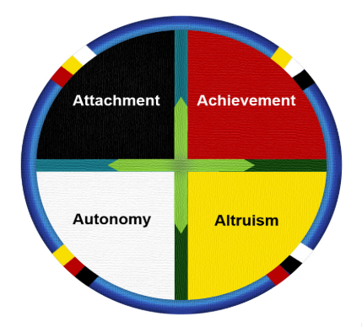
Circle of courage
++Mastery – Taking pride in competency. Often affirmed by success.
++Belonging - Primal need to feel accepted.
- - Abandonment - Look to other groups to belong.
- - Underdeveloped Mastery – “I do badly = I can’t.” Fear failure > Shutdown.
++Autonomy – Feel in control, and prove trustworthiness.
++ Generosity - Opportunities to engage in helpful behaviour.
- - Mistrustful of ability – ‘Scatterbrained’, defer responsibility.
- - “Uncaring” behaviour - Can inflict the hurt/abandonment they feel
Notes:
From Reclaiming Youth Model – Authored by Brendtro, Brokenleg and van Bockern.
ATTACHMENT: Erikson’s stages of psychosocial development – Teen roles to consolidate: identity vs role confusion - Adolescents who are successful at this stage have a strong sense of identity and are able to remain true to their beliefs and values in the face of problems and other people’s perspectives. Maslow’s Hierarchy of Needs– just one step up from primal need (physical safety) is love and belonging.
Promotes how we make attachments later – if don’t feel belong - If not met, look to negative groups and disregard others outside of the group. Can come from lack of positive contact or feelings of abandonment by people >resistant to efforts by well-meaning people (i.e., teachers, counsellors) – fear rejection or fear not being worthy and so self-fulfilling prophecy: scare away the consistency they need the most!
ACHIEVEMENT: Mastery – Frequently rewarded for efforts and therefore see what behaviour to continue. They believe in themselves because they are often affirmed by results. Willing to take risks > opportunities to learn – worked for them in the past.
Underdeveloped Mastery: Impaired sense of mastery: low self esteem and holes in their self concept (I don’t know = I am stupid). They may refuse to attempt a task for fear of failure, give up easily, be dependent on others' continuous guidance in order to engage in or continue on a task, and/or may devalue and ridicule schooling or the efforts of others.
Need CONSISTENT, unconditional praise of EFFORT, not results – Message of “I see you trying”.
AUTONOMY: Feel in control (comfortable to take learning risks as they were rewarded in the past) and have proved that they can be trusted with studying, in leadership, and in their homes.
If have lessened or absent sense of autonomy/independence are likely to engage in "scatter-brained" or disorganized behavior, be easily swayed by others into engaging in irresponsible or inappropriate actions, and blame circumstances/others for their actions, as they feel out of control.
ALTRUSIM: Generosity - Opportunities to engage in helpful behaviour – making a difference – leading/coaching a team is a good way to show responsibility and builds up independence/autonomy. If this is well-developed, they come across as empathetic and caring.
Those who have a distorted or absent sense of generosity might display behaviors described as "stingy", "callous", "uncaring", and lacking in concern for the welfare of others. They "take" rather than "give" or show their malformed sense of generosity in odd ways (e.g., being overly giving due to feelings of obligation, buy boys tuck to ‘buy’ into friendship groups. Far end – hurt without feelings of malice.
Those who generally get it right in the class, have begun to consolidate these skills. Those who haven’t, often display the behaviours we find really challenging.

Slide 8
Students
Devon
Student words:
“I appreciate it when my teacher…”
“I dislike when my teacher…”
Coaches
Notes:
Story of Devon. “Devon, what do you need?”
I appreciate it when my teacher: Gives me ANOTHER chance; recognises when I try; gives me a send-up when I improve so others can see; finds out about me; asks about me.
I dislike it when my teacher…shouts – I just get mad back; punishes me without explaining why; says I should be in another class/set (belonging).
Why coaches make good teachers – Sarah Darren.
They understand how to reach multiple goals with different personalities.
They are used to a running appraisal of the behaviour that they want – clearly, with steps to reach the goal.
They are aware of differing levels of development, recognising improvement, and voicing their ideas for improvement.
They affirm teamwork, which improves classroom peer-to-peer help, and helps the class to appreciate the flavour each member brings to the group.
Coaches inwardly reflect, often. They stay ahead of the game in terms of techniques and strategies, and are open to questioning their own leadership to get the best out of their players.

Slide 9
connecting
Don’t take it personally – model self-regulation
Watch out for assumptions
Kids do well if they can – Skill not Will
Adding YET to the journey – “John doesn’t know how to pay attention … YET”
Repeat expectations, and reward/positive affirmation when they are met – I SEE YOU
Everyone belongs – by virtue of being in a class – each student has a role
Safe to take learning risks – Affirm EFFORTS over RESULTS - Unconditional regard.
Start fresh everyday
Circle of Courage, Dr Ablon, and Grace Dearborn – Compassionate School Discipline (Learning and the Brain Conference) - Educating with Empathy
Notes:
Students are not intentionally trying to derail your lesson. We may need to take more deep breaths with some boys more than others – they need us to!
Assumptions – we assume things about a boy which can stick. Clean slate!
Kids do well is they can – where there is a Skill there’s a WAY!
YET – helps you see this is a journey.
Everybody belongs: “For me, the invisible subtitle for ‘I don’t care’ is, Mrs. Dearborn, I really, really care, but I can’t tell you that. Do you care?” Reading the “subtitles,” as she calls them, has helped Dearborn to stop perceiving misbehavior as disrespect. That doesn’t make her a pushover, she said. It makes her an advocate for the student. “So now when kids say, ‘I don’t care’ to me, I say, ‘That’s OK because I care, and I can care for the both of us right now, so let’s do this.’ ”
5. Expectations and Affirmation –Still learning – may need to explain the expectations more overtly, and more often. Affirmations - “catch them being good” – especially attention-seeking – reward the behavior you want to see more of. I SEE YOU!
6. You belong. Each student has a role – help them find out what is it.
7. It is SAFE! This is a learning zone, not a gladiator pit! Affirm EFFORTS over RESULTS, unconditionally.
Start afresh every day – This is the learning zone – I will not hold your behavior yesterday against you – we try again. It is safe.

Slide 10
Thoughts or questions?

