Slide 1
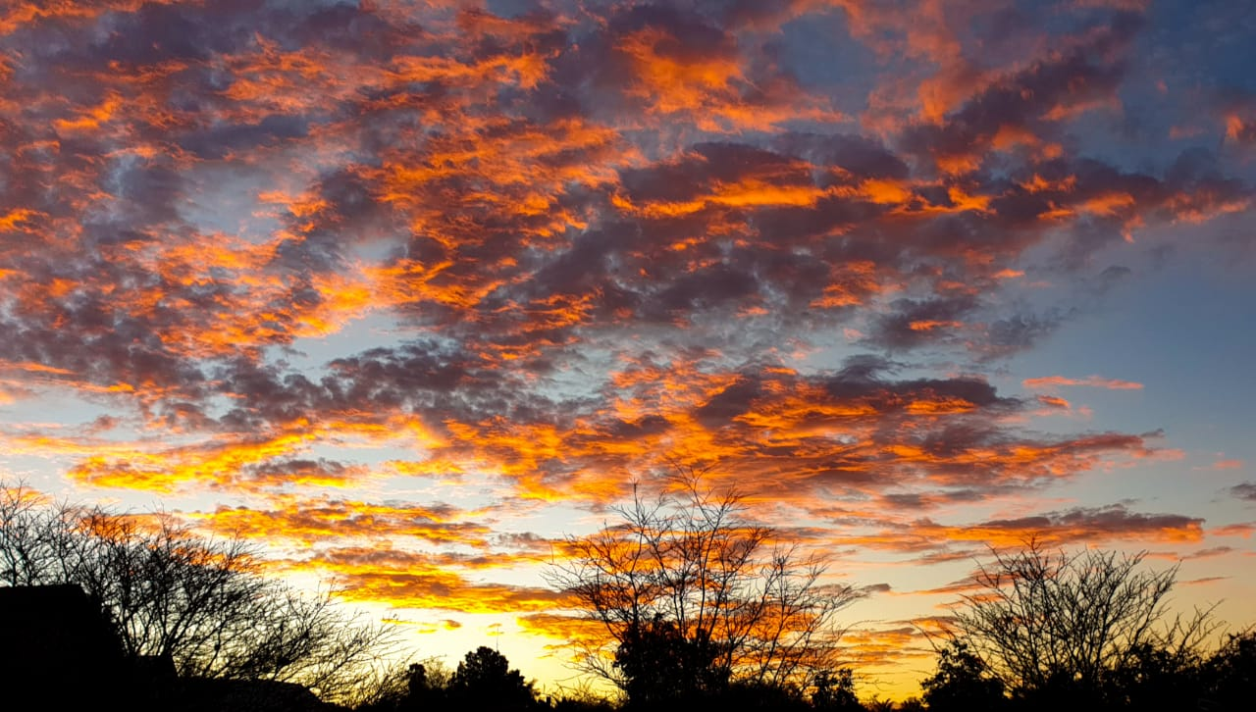
Nicola
Your name
2021 Vision Board
Colouring in my life in 2021

Slide 2
2021
Joy
growth
excellence

Slide 3
Joy

Slide 4
XYZ

Slide 5
Growth

Slide 6
XYZ

Slide 7
Excellence

Slide 8
XYZ

Slide 9
Nikki’s Vision for 2021
Joy
growth
excellence

Slide 10
Joy

Slide 11
See Wildflowers Western Cape

Slide 12
Growth

Slide 13
More international speaking

Slide 14
Excellence

Slide 15
New book published July 2021

